Slide 1
Where does the error come from?

Slide 2
Slide credits
Most of these slides were adapted from:
Hung-yi Lee (National Taiwan University)
Kris Kitani (Carnegie Mellon University).
Noah Snavely (Cornell University).
Fei-Fei Li (Stanford University).

Slide 3
Please read the book
Bishop, Pattern Recognition and Machine Learning
Chapter 3.2

Slide 4
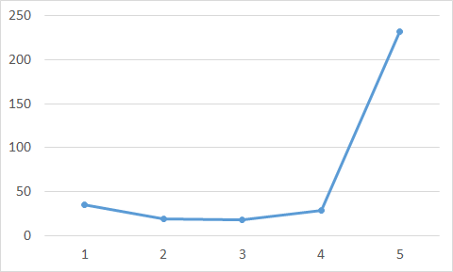
Review
Average Error on Testing Data
error due to "bias" and error due to "variance"
A more complex model does not always lead to better performance on testing data.

Slide 5
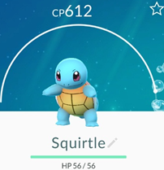
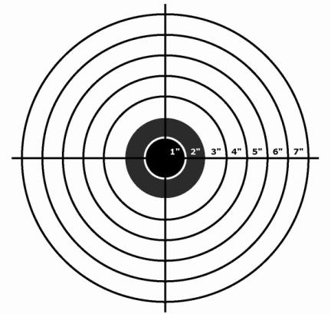
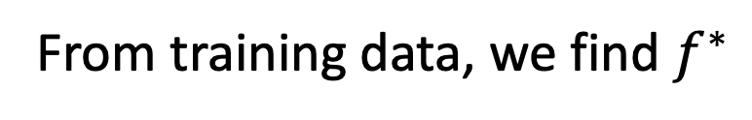
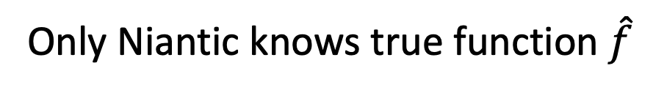
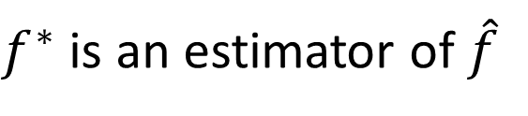

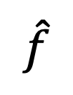

Estimator
Bias + Variance
$$f^{∗}$$
$$\hat{y}=\hat{f}\left( \right)$$
Only Niantic knows true function $\hat{f}$
$$\hat{f}$$
From training data, we find $f^{∗}$
$f^{∗}$ is an estimator of $\hat{f}$

Slide 6













Bias and Variance of Estimator
unbiased
Estimate the mean of a variable x
assume the mean of x is $μ$
assume the variance of x is $σ^{2}$
Estimator of mean $μ$
Sample N points: $\left\{x^{1},x^{2},…,x^{N}\right\}$
$$m_{2}$$
$$m_{5}$$
$$m_{1}$$
$$μ$$
$$m=\frac{1}{N}\sum_{n}{x^{n}}$$
$$≠μ$$
$$m_{4}$$
$$m_{3}$$
$$E\left[m\right]=E\left[\frac{1}{N}\sum_{n}{x^{n}}\right]$$
$$=\frac{1}{N}\sum_{n}{E\left[x^{n}\right]}$$
$$=μ$$
$$m_{6}$$

Slide 7




Bias and Variance of Estimator
Estimate the mean of a variable x
assume the mean of x is $μ$
assume the variance of x is $σ^{2}$
Estimator of mean $μ$
Sample N points: $\left\{x^{1},x^{2},…,x^{N}\right\}$
Smaller N
Larger N
$$m=\frac{1}{N}\sum_{n}{x^{n}}$$
$$≠μ$$
$$μ$$
$$μ$$
Variance depends on the number of samples
$$Var\left[m\right]=\frac{σ^{2}}{N}$$

Slide 8








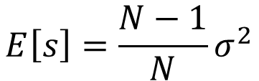




Bias and Variance of Estimator
Increase N
Estimate the mean of a variable x
assume the mean of x is $μ$
assume the variance of x is $σ^{2}$
Estimator of variance $σ^{2}$
Sample N points: $\left\{x^{1},x^{2},…,x^{N}\right\}$
$$s_{3}$$
$$σ^{2}$$
$$σ^{2}$$
$$s_{1}$$
$$m=\frac{1}{N}\sum_{n}{x^{n}}$$
$$s=\frac{1}{N}\sum_{n}{{\left(x^{n}−m\right)}^{2}}$$
$$s_{4}$$
$$s_{5}$$
Biased estimator
$$s_{2}$$
$$s_{6}$$
$$E\left[s\right]=\frac{N−1}{N}σ^{2}$$
$$≠σ^{2}$$

Slide 9
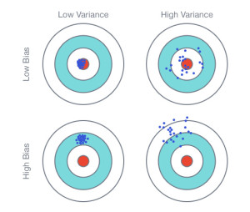



$$E\left[f^{∗}\right]=\overline{f}$$
$$f^{∗}$$
Variance
Bias
$$\hat{f}$$

Slide 10
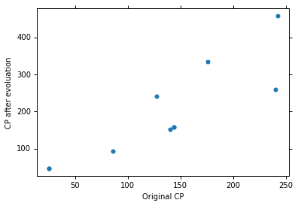
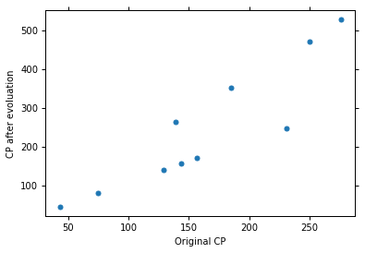
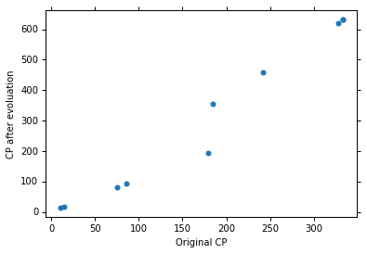
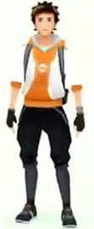
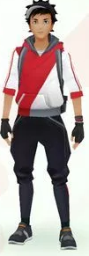
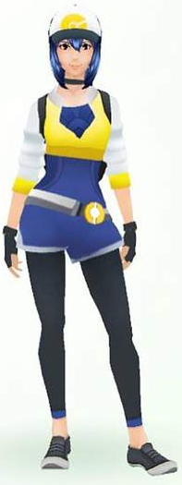

Parallel Universes
In all the universes, we are collecting (catching) 10 Pokémons as training data to find $f^{∗}$
Universe 1
Universe 2
Universe 3

Slide 11
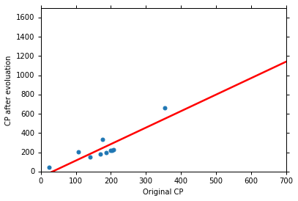
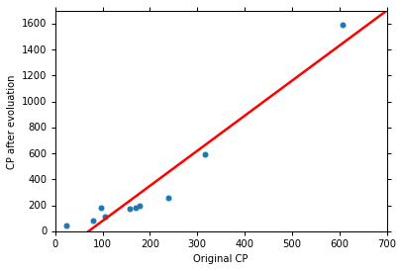

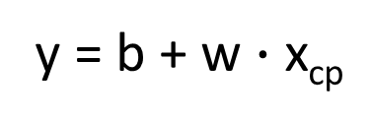
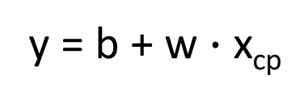
Parallel Universes
In different universes, we use the same model, but obtain different $f^{∗}$
Universe 123
Universe 345
y = b + w $∙$ x_{cp}
y = b + w $∙$ x_{cp}

Slide 12
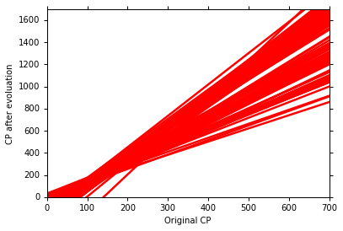
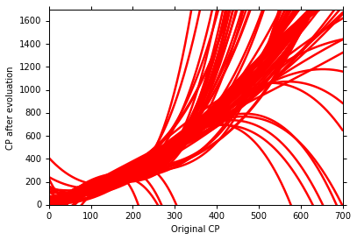
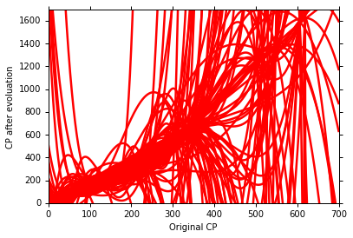
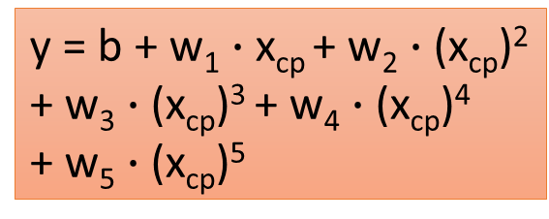
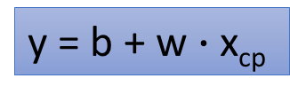
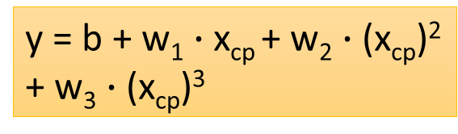
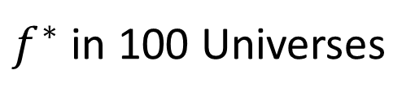
$f^{∗}$ in 100 Universes
y = b + w $∙$ x_{cp}
y = b + w₁ $∙$ x_{cp} + w₂ $∙$ (x_{cp})²
+ w₃ $∙$ (x_{cp})³
y = b + w₁ $∙$ x_{cp} + w₂ $∙$ (x_{cp})²
+ w₃ $∙$ (x_{cp})³ + w₄ $∙$ (x_{cp})⁴
+ w₅ $∙$ (x_{cp})⁵

Slide 13
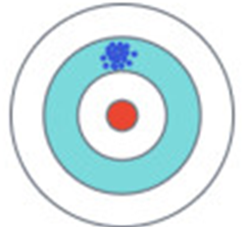
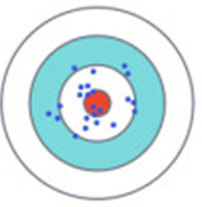

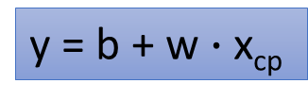
Variance
y = b + w₁ $∙$ x_{cp} + w₂ $∙$ (x_{cp})²
+ w₃ $∙$ (x_{cp})³ + w₄ $∙$ (x_{cp})⁴
+ w₅ $∙$ (x_{cp})⁵
y = b + w $∙$ x_{cp}
Small
Variance
Large
Variance
Simpler model is less influenced by the sampled data
Consider the extreme case f(x) = 5

Slide 14
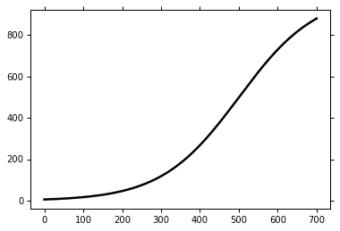


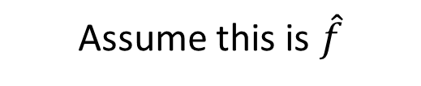
Bias
$$E\left[f^{∗}\right]=\overline{f}$$
Bias: If we average all the $f^{∗}$, is it close to $\hat{f}$ ?
Large
Bias
Assume this is $\hat{f}$
Small
Bias

Slide 15
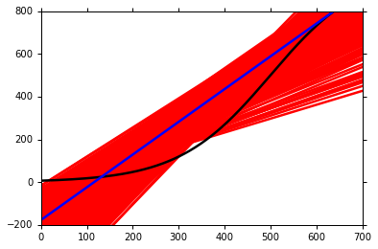
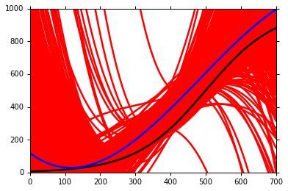
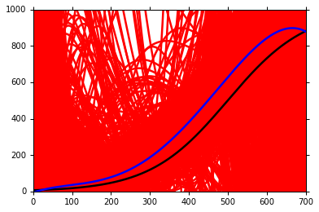

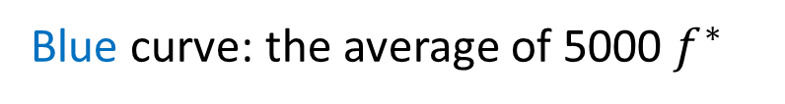
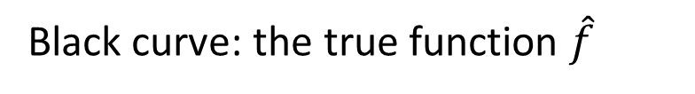
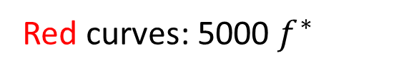
Black curve: the true function $\hat{f}$
Red curves: 5000 $f^{∗}$
Blue curve: the average of 5000 $f^{∗}$
$$=\overline{f}$$

Slide 16
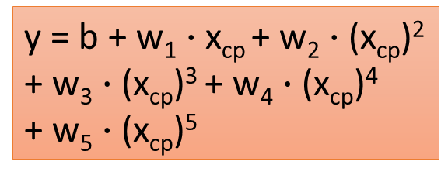
Bias
y = b + w₁ $∙$ x_{cp} + w₂ $∙$ (x_{cp})²
+ w₃ $∙$ (x_{cp})³ + w₄ $∙$ (x_{cp})⁴
+ w₅ $∙$ (x_{cp})⁵
y = b + w $∙$ x_{cp}
Large
Bias
Small
Bias
model
model

Slide 17
Bias v.s. Variance
Error from bias
Error from variance
Error observed
Underfitting
Overfitting
Large Bias
Small Bias
Small Variance
Large Variance

Slide 18
What to do with large bias?
Diagnosis:
If your model cannot even fit the training examples, then you have large bias
If you can fit the training data, but large error on testing data, then you probably have large variance
For bias, redesign your model:
Add more features as input
A more complex model
Underfitting
Overfitting
large bias

Slide 19




What to do with large variance?
More data
Regularization
Very effective, but not always practical
10 examples
100 examples
May increase bias

Slide 20
Model Selection
There is usually a trade-off between bias and variance.
Select a model that balances two kinds of error to minimize total error
What you should NOT do:
Training Set
Testing Set
Real Testing Set
Model 1
Err = 0.9
(not in hand)
Model 2
Err = 0.7
Model 3
Err = 0.5
Err > 0.5

Slide 21

public
private
Training Set
Testing Set
Testing Set
Model 1
Err = 0.9
Model 2
Err = 0.7
Model 3
Err = 0.5
Err > 0.5
I beat baseline!
No, you don’t
What will happen?
http://www.chioka.in/how-to-select-your-final-models-in-a-kaggle-competitio/

Slide 22
Cross Validation
public
private
Training Set
Testing Set
Testing Set
Training Set
Validation
set
Using the results of public testing data to tune your model
You are making public set better than private set.
Model 1
Err = 0.9
Model 2
Err = 0.7
Not recommend
Model 3
Err = 0.5
Err > 0.5
Err > 0.5

Slide 23
N-fold Cross Validation
Training Set
Model 1
Model 2
Model 3
Train
Train
Val
Err = 0.2
Err = 0.4
Err = 0.4
Train
Val
Train
Err = 0.4
Err = 0.5
Err = 0.5
Val
Train
Train
Err = 0.3
Err = 0.6
Err = 0.3
Avg Err
= 0.3
Avg Err
= 0.5
Avg Err
= 0.4
Testing Set
Testing Set
public
private

